Slide 1
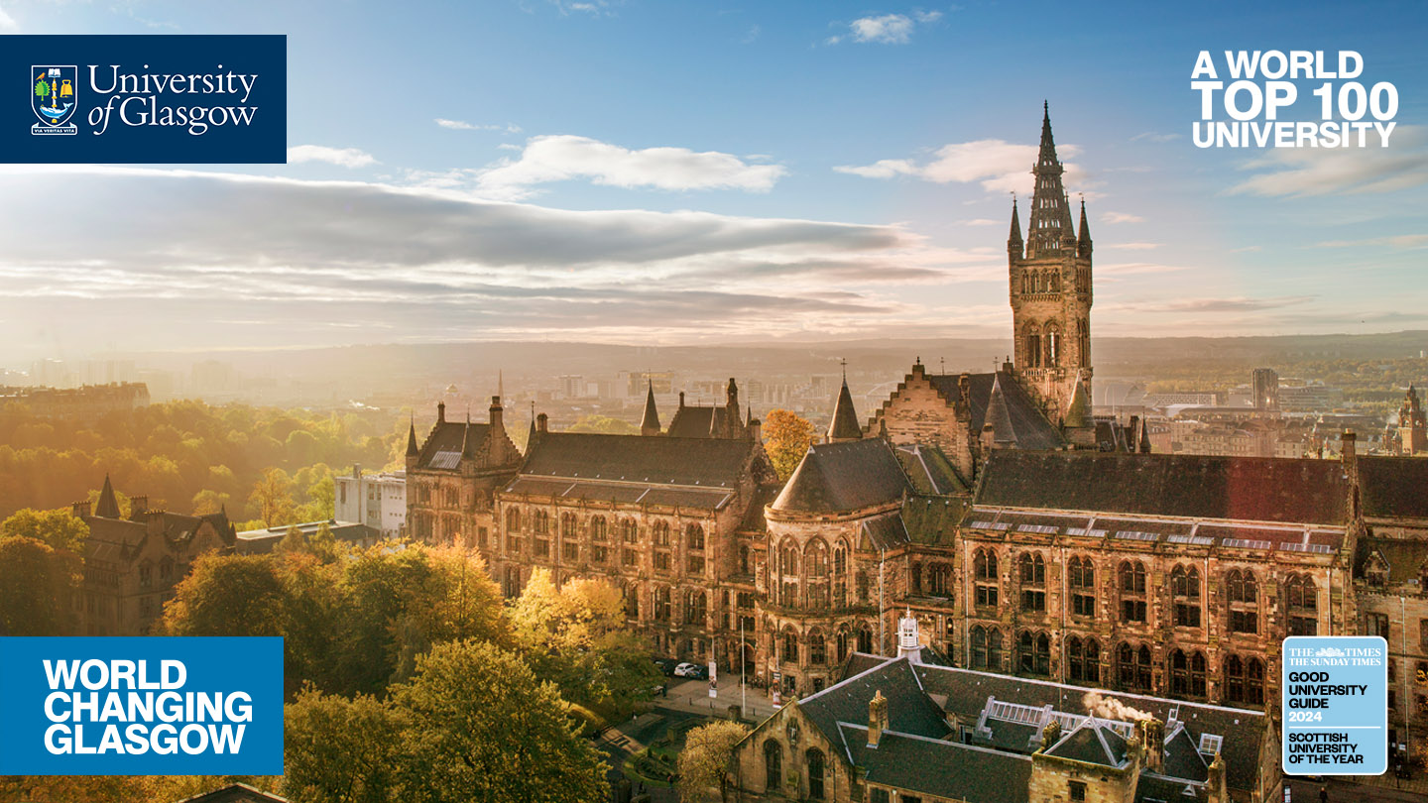
IPS 796 – Emerging Trends in Digital Twins
Chair: Dr Andrew Elliott, University of Glasgow UK
Organisers: Dr Andrew Elliott, Dr Vinny Davies, Dr Daniela Castro-Camilo, Prof Marian Scott & Prof Claire Miller, University of Glasgow, UK.

Slide 2
Today’s Session
What is a Digital Twin? – Dr Vinny Davies, University of Glasgow, UK.
Bluebird: A digital twin of UK airspace for air traffic control – Dr Nick Barlow, The Alan Turing Institute, UK.
Capturing and quantifying uncertainties in agricultural (farm-scale) digital twins – Prof Andrew Mead & Prof Paul ‘Harry’ Harris, Rothamsted Institute, UK.
A discussion (if time allows)

Slide 3
What is a Digital Twin?
Dr Vinny Davies
Senior Lecturer in Statistics, University of Glasgow

Slide 4
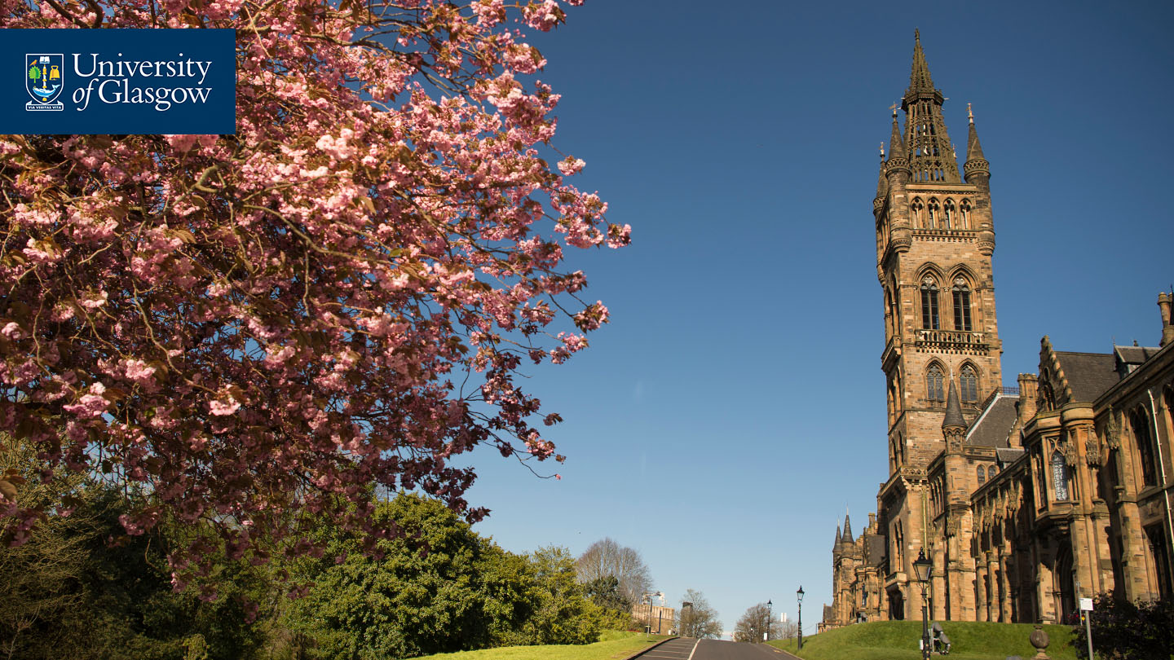
This Talk
A general introduction to digital twins
RSS Mardia prize for hosting workshops on ‘Analytics for Digital Earth’
Some recent research in the School of Mathematics & Statistics @ University of Glasgow

Slide 5
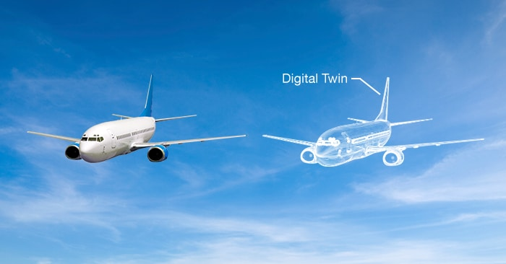
What is a Digital Twin?
A digital twin is essentially a digital replica of some real-life process
Generally, the digital twin will be a computerised version of the real-life process that allows us to simulate the process and understand what would happen in different situations

Slide 6
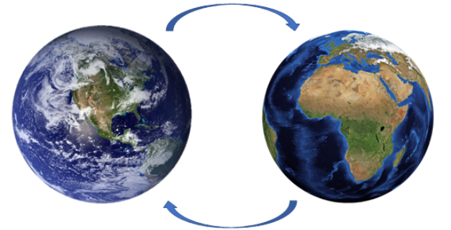
A Digital Earth
Our school won the RSS’s Mardia Prize to host workshops on ‘Analytics for Digital Earth’, exploring how we can make a digital twin of the Earth
6 workshops between 2022 and 2025 hosted at the University of Glasgow

Slide 7
Environmental Digital Twins
More realistically a digital twin might represent a smaller system such as say a river or a city
River twin may include flooding, biodiversity, and pollution
City twin might include traffic, air quality, and pedestrians
Alternatively, a digital twin might just focus one particular element, e.g., flooding, weather, biodiversity
Each model could then be used to help several different applications

Slide 8


So, what actually is a Digital Twin?
Digital Twin
Real System

Slide 9
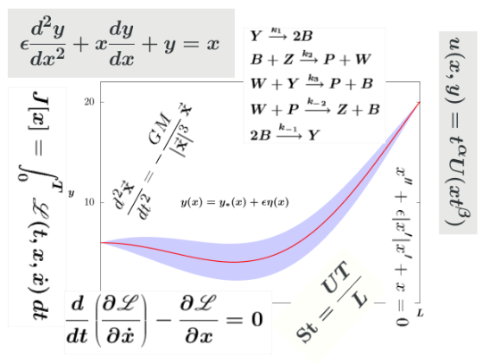
So, what actually is a Digital Twin?
Physical Model
Digital Twin
Real System

Slide 10
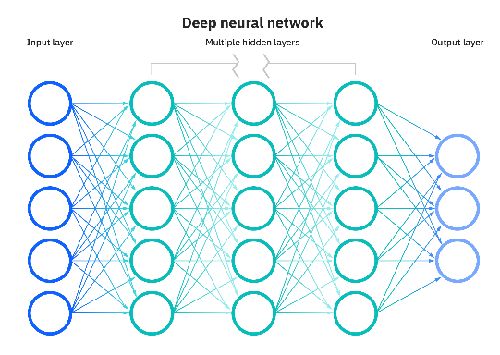
So, what actually is a Digital Twin?
ML / AI Model
Digital Twin
Real System

Slide 11

So, what actually is a Digital Twin?
Digital Twin
Real System
Code

Slide 12
So, what actually is a Digital Twin?
Physical Model
ML / AI Model
Digital Twin
Real System
Code

Slide 13
So, what actually is a Digital Twin?
Digital Twin
Physical Model
ML / AI Model
Digital Twin
Real System
Code

Slide 14
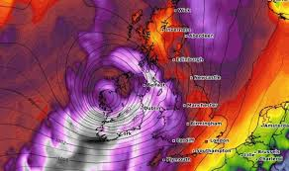
So, what actually is a Digital Twin?
Weather Data
Digital Twin
Physical Model
ML / AI Model
Digital Twin
Code

Slide 15
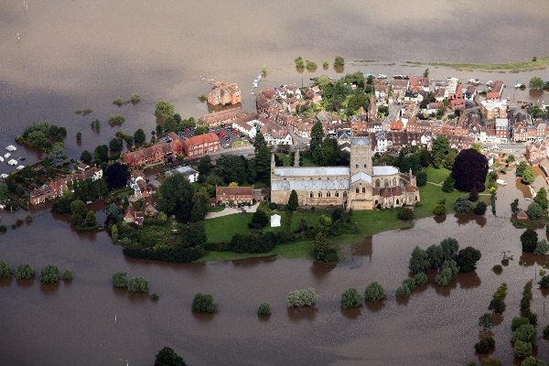
So, what actually is a Digital Twin?
Weather Data
Digital Twin
Physical Model
Flooding Data
ML / AI Model
Digital Twin
Code

Slide 16
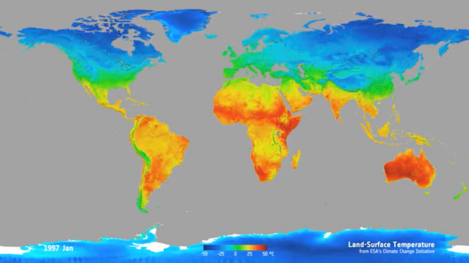
So, what actually is a Digital Twin?
Weather Data
Digital Twin
Physical Model
Flooding Data
ML / AI Model
Temperature Data
Digital Twin
Code

Slide 17
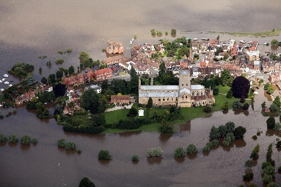

So, what actually is a Digital Twin?
Data
Digital Twin
Physical Model
ML / AI Model
Digital Twin
Code

Slide 18
So, what actually is a Digital Twin?
Training models and parameters
We can use the combination of our digital twin and available data to train the models and parameters of the digital twin
Data
Digital Twin
Physical Model
ML / AI Model
Digital Twin
Code

Slide 19
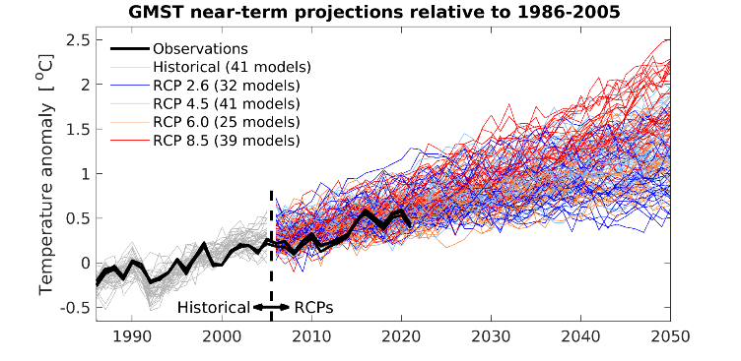
So, what actually is a Digital Twin?
Training models and parameters
We can use the combination of our digital twin and available data to train the models and parameters of the digital twin
Data
Digital Twin
Physical Model
ML / AI Model
Scenario Planning
Digital Twin
Code

Slide 20
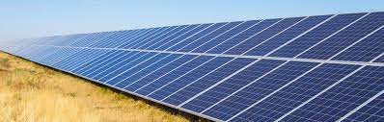
So, what actually is a Digital Twin?
Training models and parameters
We can use the combination of our digital twin and available data to train the models and parameters of the digital twin
Data
Digital Twin
Physical Model
ML / AI Model
Scenario Planning
Digital Twin
Tool / Intervention
Code

Slide 21

So, what actually is a Digital Twin?
Practically, a large digital twin will be a combination of multiple existing digital twins
Data may potentially link to some parts of the digital twin but not others
How to combine these is one of the major current challenges related to digital twins
Similarly, how to link data effectively to the digital twins

Slide 22
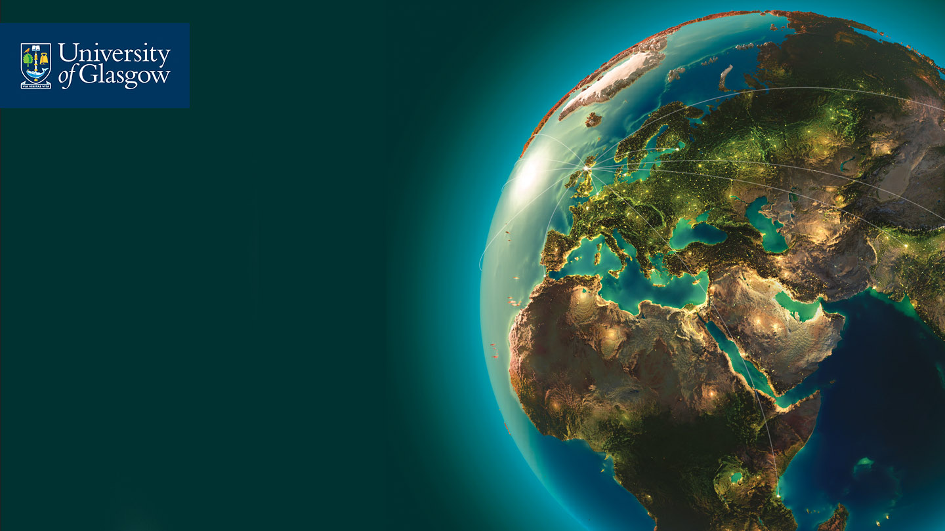
Challenges with Environmental Digital Twins
The Mardia workshops identified the following key challenges:
Effective data collection
Fusing data sources
Joining digital twins
Uncertainty quantification
Understanding stakeholders
Identifying co-benefits

Slide 23
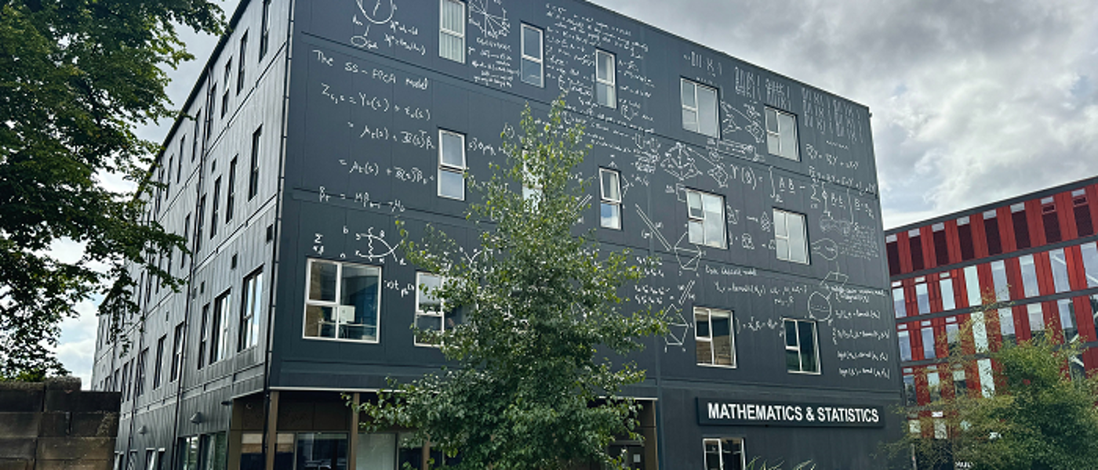

Statistics Group @ University of Glasgow
School of Mathematics and Statistics
Around 35 Academics, 5-10 Postdocs, and 50 PhD Students
AI3 Initiative – Analytics, Inference, Innovation & Impact
Co-leading several large centres
SofTMech
GALLANT
ExaGEO

Slide 24
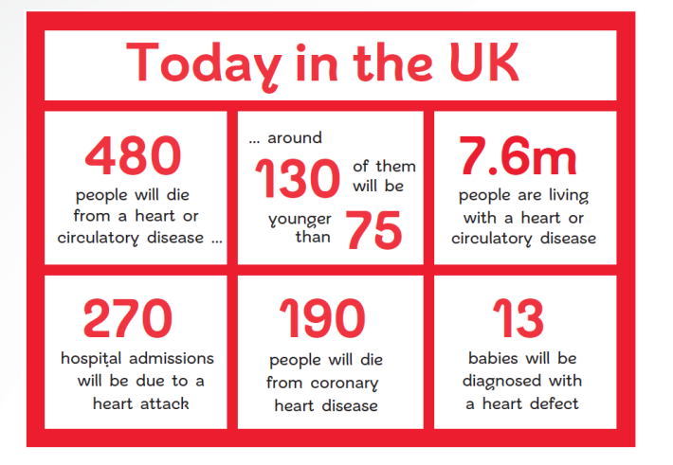
Heart Attacks
There are approximately 50,000 premature deaths from heart and circulatory diseases every year in the UK
Fast personalised treatment can help reduce the number of deaths
British Heart Foundation

Slide 25
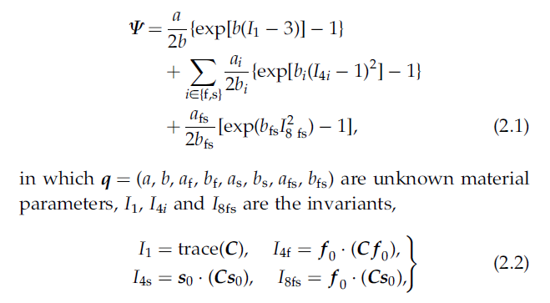
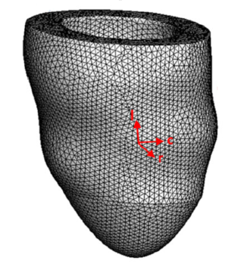
Mathematical Modelling
Mathematical modelling can help us understand muscle and fluid movements
Complex models exist for left ventricles and other parts of the heart

Slide 26
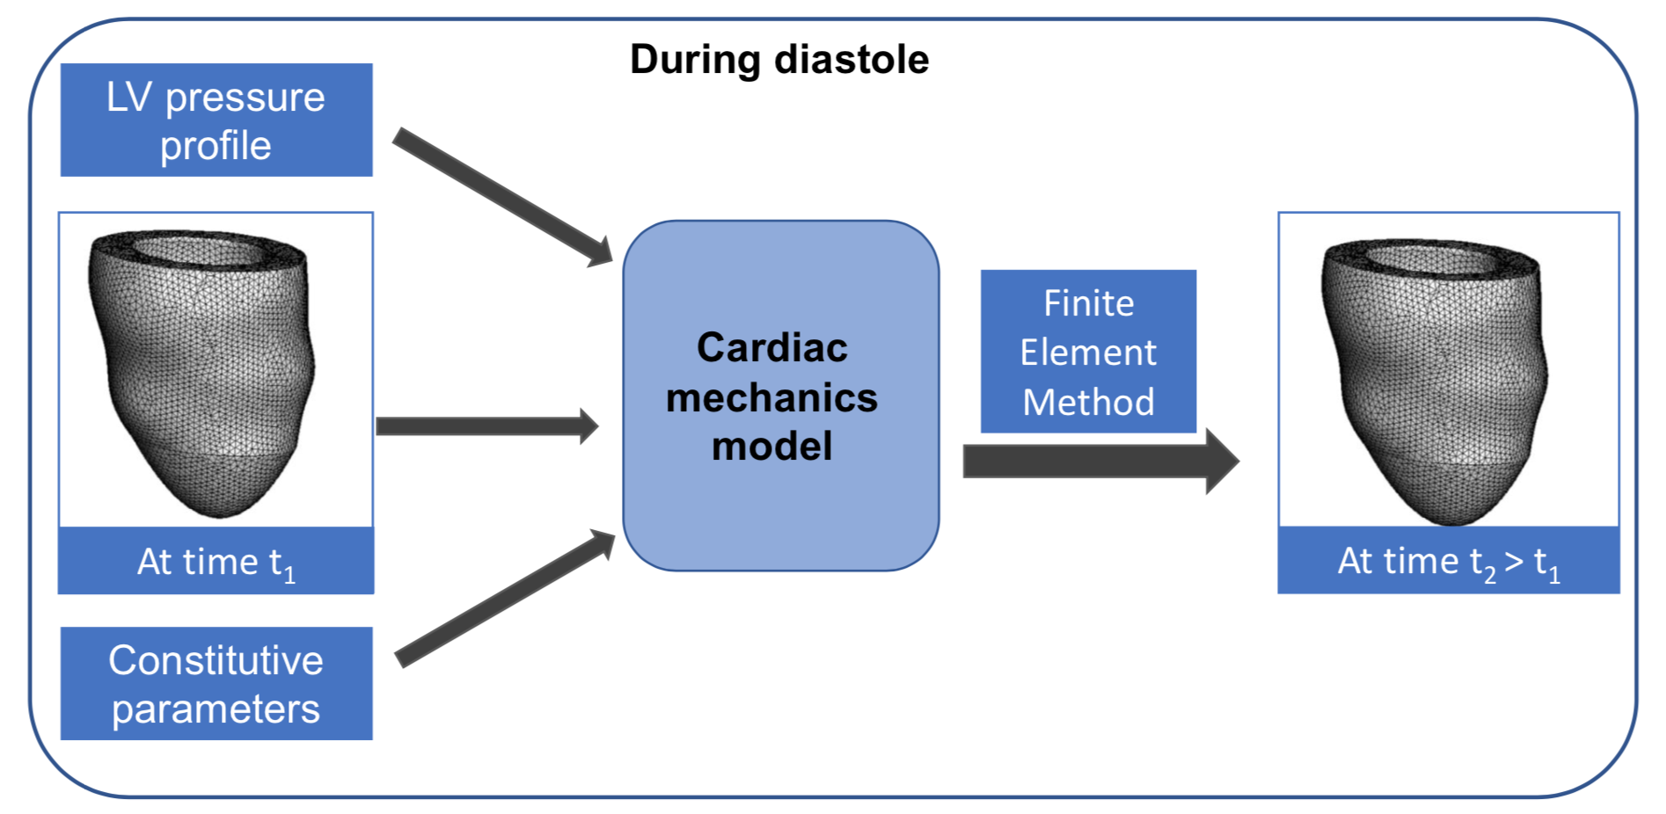
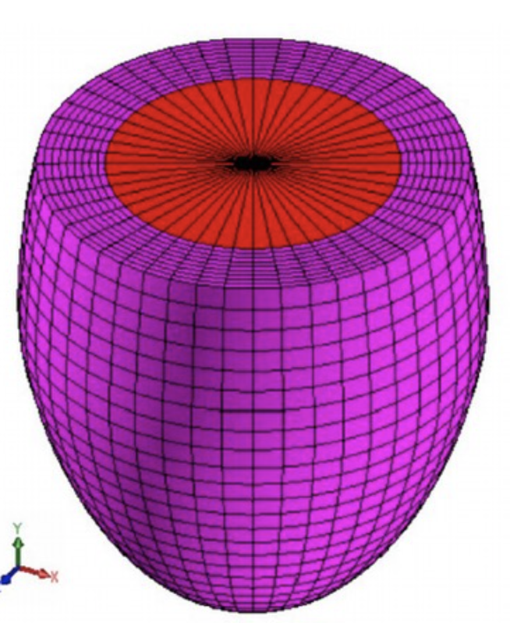
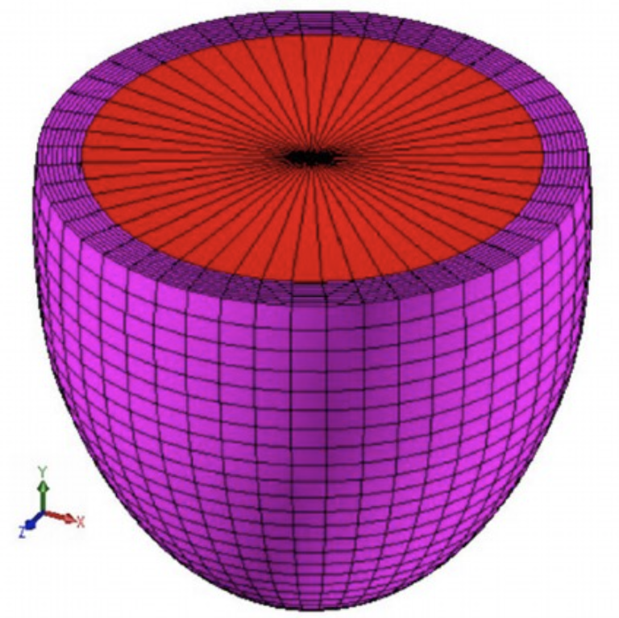
Modelling Process
Cardiac Mechanics Digital Twin
Figure thanks to Dirk Husmeier

Slide 27
Modelling Process
Cardiac Mechanics Digital Twin
Figure thanks to Dirk Husmeier

Slide 28
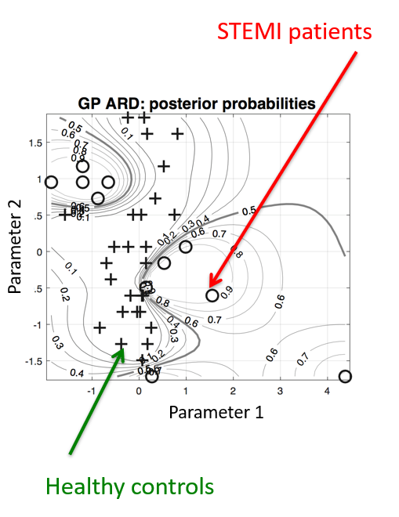
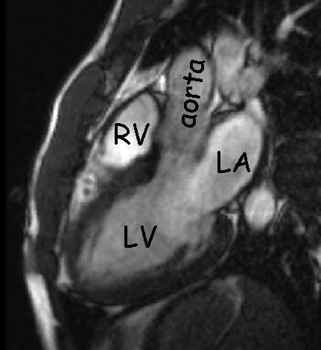
Advantages of Mathematical Models
Have interpretable real-world parameters
Parameters can be used as diagnostic tools for personalised medicine
Mathematical models essentially represent a digital twin of the left ventricle

Slide 29
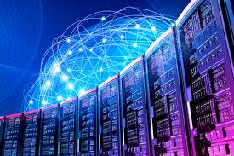
Linking to Data
Cardiac Mechanics Digital Twin
Figure thanks to Dirk Husmeier

Slide 30
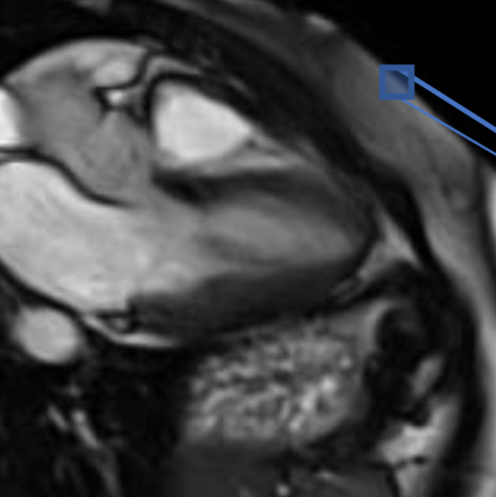
Linking to Data
Cardiac Mechanics Digital Twin
Figure thanks to Dirk Husmeier

Slide 31
Linking to Data
Cardiac Mechanics Digital Twin
Figure thanks to Dirk Husmeier

Slide 32
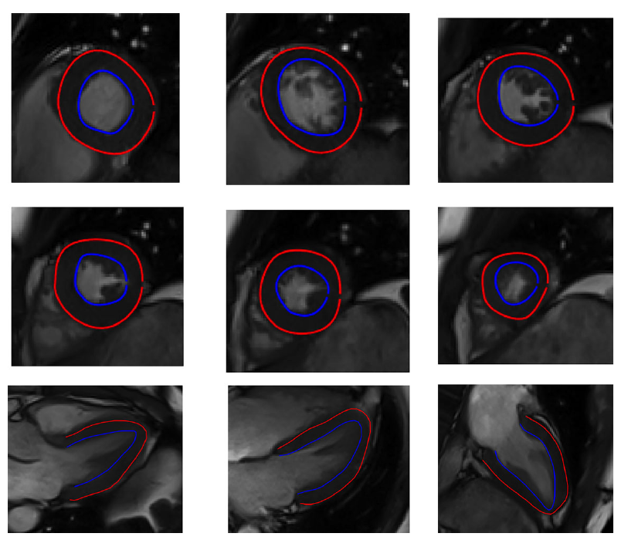
Image Annotation
To link the models to the images, we need to be able to create the 3D mesh
Annotation can be done automatically, but currently unreliable

Slide 33

Learning Parameters
Cardiac Mechanics Digital Twin
Compare and minimise the difference to learn parameters
Figure thanks to Dirk Husmeier

Slide 34
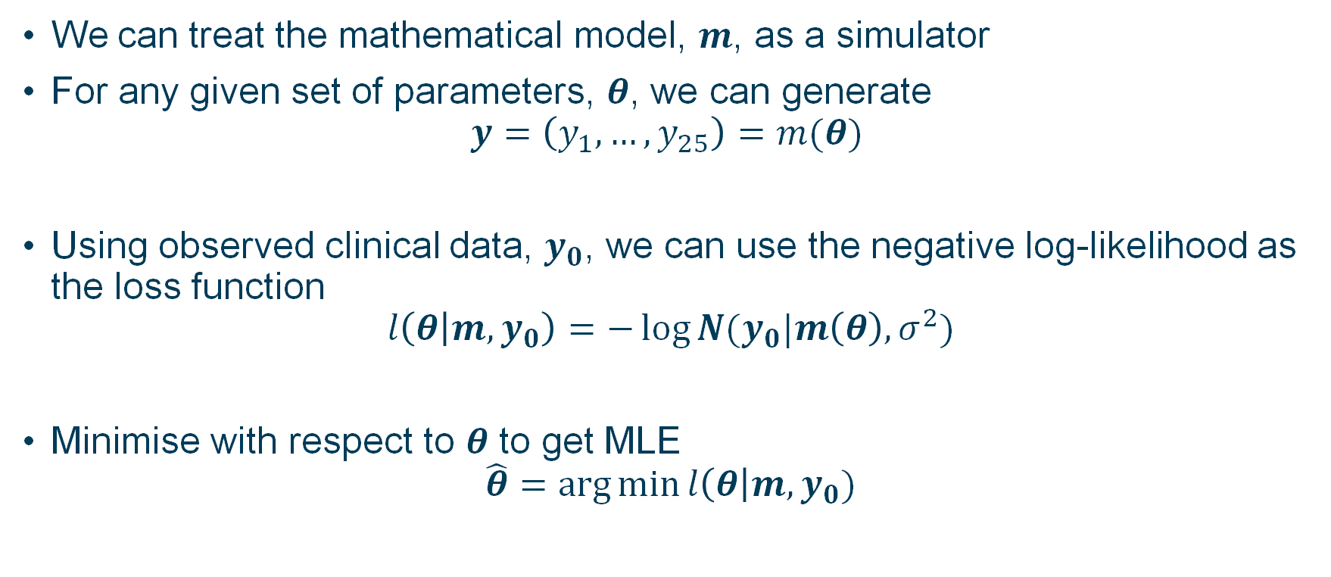
Optimisation of Mathematical Models
We can treat the mathematical model, $m$, as a simulator
For any given set of parameters, $θ$, we can generate
$$y=\left(y_{1}, …, y_{25}\right)=m(θ)$$
Using observed clinical data, $y_{0}$, we can use the negative log-likelihood as the loss function
$$l\left(θ | m, y_{0}\right)=−\log{N(y_{0}|m\left(θ\right), σ^{2})}$$
Minimise with respect to $θ$ to get MLE
$$\hat{θ}=\arg{\min{l\left(θ\right|m, y_{0})}}$$

Slide 35
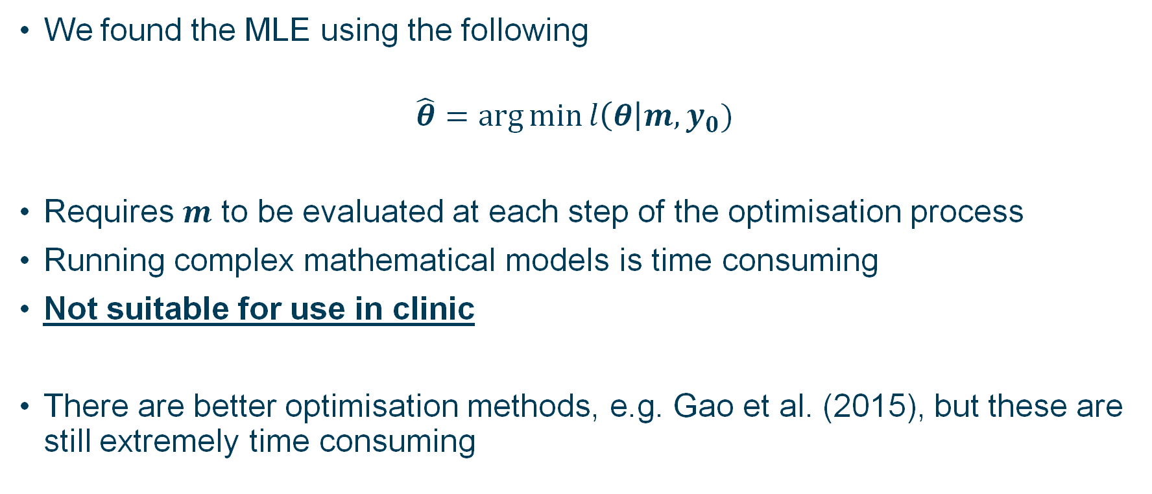
Problems with Optimisation
We found the MLE using the following
$$\hat{θ}=\arg{\min{l\left(θ\right|m, y_{0})}}$$
Requires $m$ to be evaluated at each step of the optimisation process
Running complex mathematical models is time consuming
Not suitable for use in clinic
There are better optimisation methods, e.g. Gao et al. (2015), but these are still extremely time consuming
Gao et al. (2015), J. Engineering Mathematics

Slide 36
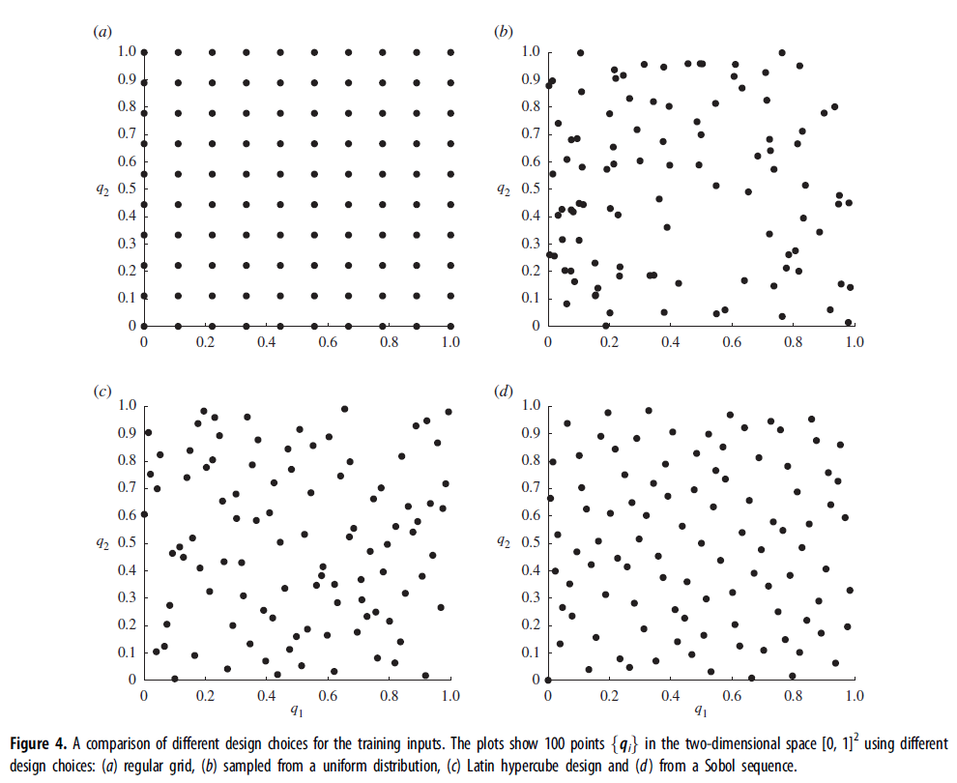
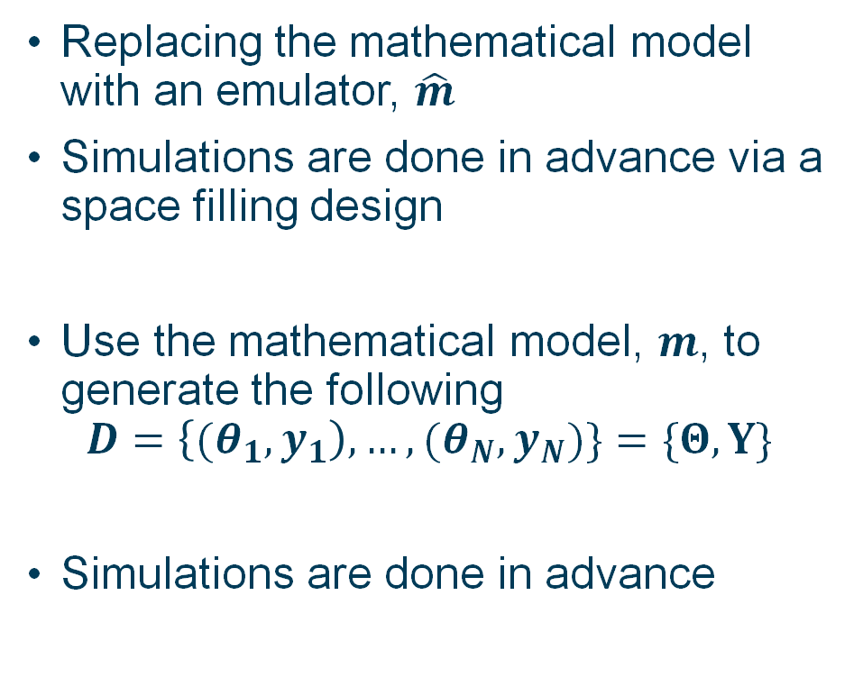
Emulation & Space Filling Designs
Replacing the mathematical model with an emulator, $\hat{m}$
Simulations are done in advance via a space filling design
Use the mathematical model, $m$, to generate the following
$$D=\left\{{(θ}_{1},y_{1}\right), …, (θ_{N},y_{N})\}=\{Θ,Y\}$$
Simulations are done in advance
Noè et al. (2019), Royal Society Interface

Slide 37
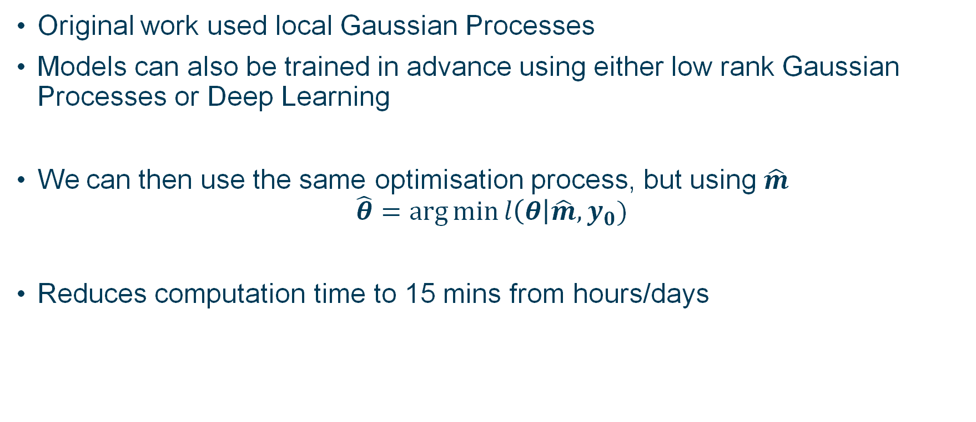
Statistical Emulation
Original work used local Gaussian Processes
Models can also be trained in advance using either low rank Gaussian Processes or Deep Learning
We can then use the same optimisation process, but using $\hat{m}$
$$\hat{θ}=\arg{\min{l\left(θ\right|\hat{m}, y_{0})}}$$
Reduces computation time to 15 mins from hours/days
Davies et al. (2019), JRSS-C

Slide 38
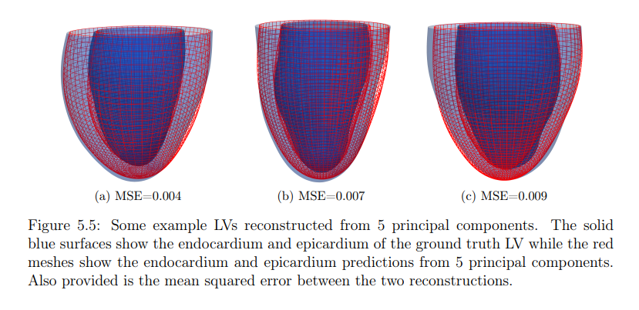
Extension to New Patients
Work can be extended to work for multiple patients
3D mesh can be represented through PCA
PCA parameters can then be used as parameters within the emulator
For a new patient, PCA components can be calculated and used as fixed components in the optimisation procedure
Lazarus (2022), PhD Thesis

Slide 39
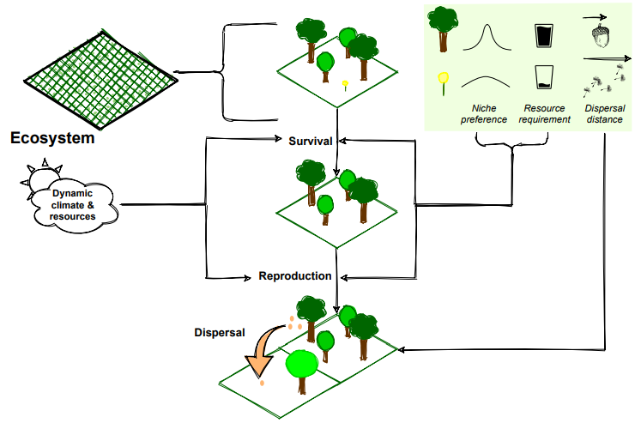
Biodiversity Digital Twins
At the University of Glasgow there is ongoing work on a plant biodiversity digital twin
EcoSISTEM simulates plant life, helping to understand the effects of climate change and local decision-making processes
There is a large biodiversity Digital Twin being developed in Europe as well
https://arxiv.org/pdf/1911.12257.pdf

Slide 40
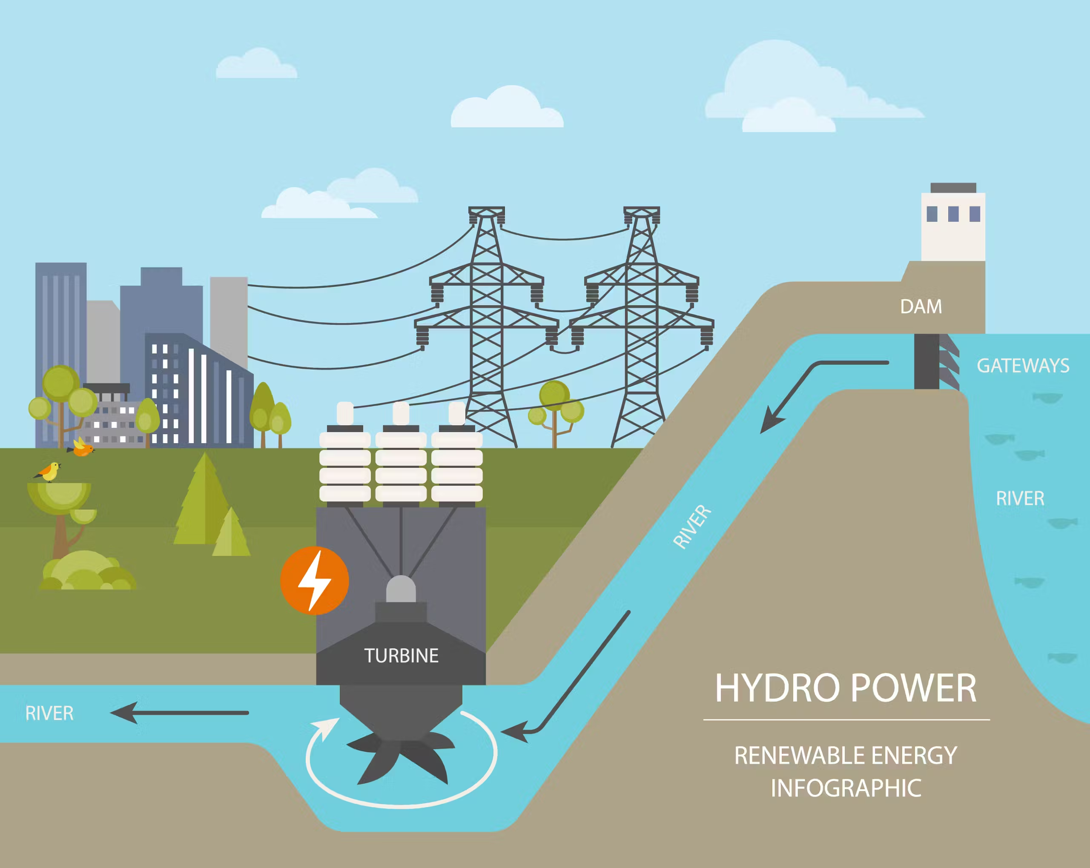
Hydropower Digital Twins
New collaboration with an energy providers
System optimisation for efficiency and reliability
Separate data driven and physical modelling approaches
Future plan to combine the two approaches for real time monitoring and control

Slide 41
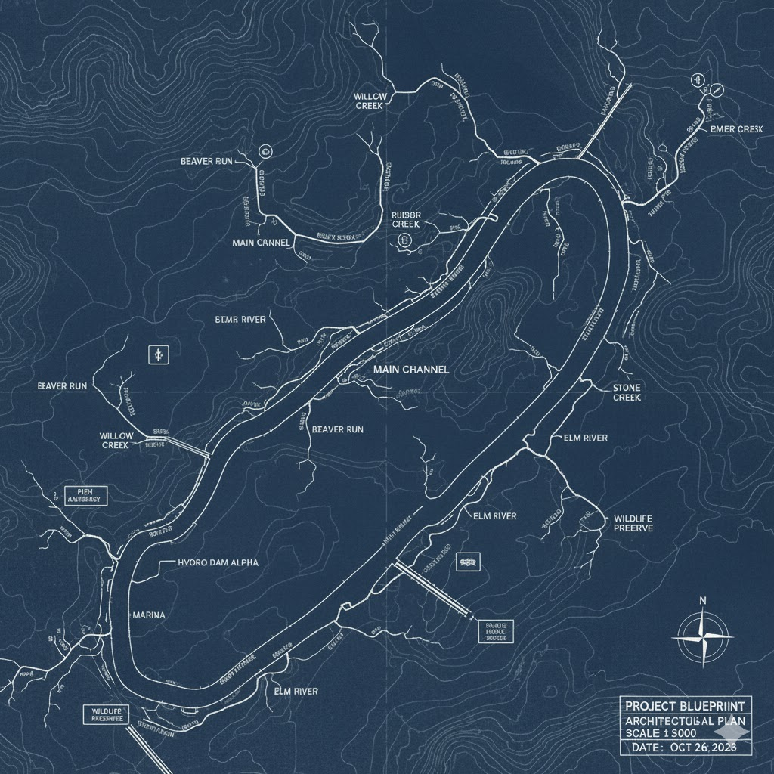
Blueprint Digital Twin
Digital twin of a river basin or catchment
Combines ‘natural’ and ‘built’ environment.
Build for a variety of use cases, including flooding and planning
Build for a variety of users, e.g. government, general public

Slide 42
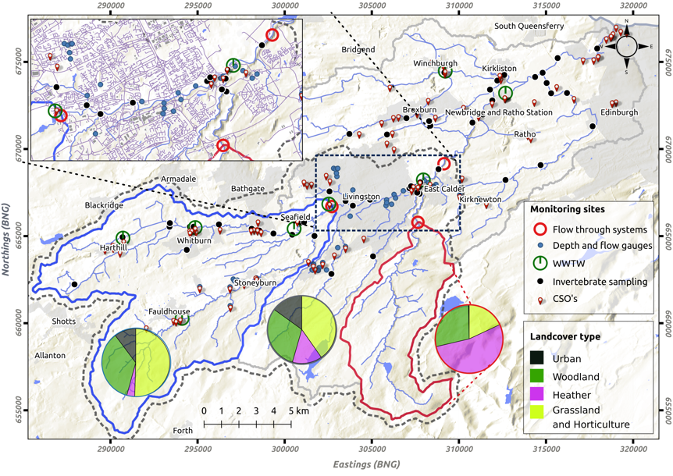
Blueprint Digital Twin
Data that are high quality
Verifiable, timely and accessible informed decisions
Interoperable and secure data framework
The DT must be able to work with:
Data and information within and across infrastructure sectors and the wider built and natural environments
Different spatial and temporal scales
Different approaches to modelling

Slide 43
Blueprint Digital Twin
In the water context, we have a suite of different model types
Process (or physics informed) (sets of differential equations)
Data driven (including AI) for time series
Networks
Hybrid Cominations
Potentially the computational burden could be high, so also considering the use of emulators.

Slide 44
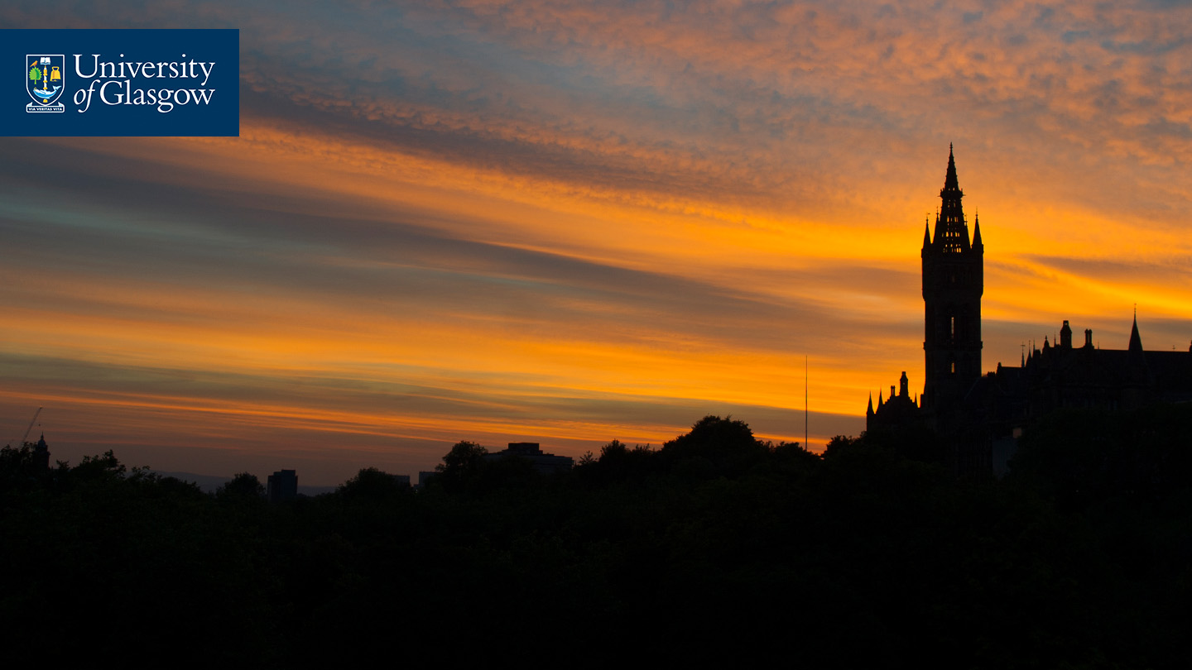



If you have any questions, then please feel free to ask. You can also contact me at Vinny.Davies@Glasgow.ac.uk Slides available at https://github.com/vinnydavies/presentations
#UofGWorldChangers
@UofGlasgow

